Slide 1


driver allert
BUSINESS PRESENTATION
Telephone
Address
Website
september 2024
0717131147
kevnal456@gmail.com
www.reallygreatsite.com

Slide 2

ABOUT US
WE ARE KEVTECHHH
at kevtech, we are a tech minded company dedicated at coming up with solutions to ensure that there is safety and productivity in day to day life. we ensure that we build solutions to manage road safety and minimise loses that has resulted to loss of lives and property due to increased number of accidents all over the world.

Slide 3

WHAT WE BELIEVE
ABOUT OUR VISION AND MISSION
VISION
our vision is to be safety champions and ensure that no lives are lost on the roads and that no property is destroyed as a result of accidents.
MISSION
Our mission is to deliver solutions that will be able to monitor the status on the roads and also produce electronic gadgets both for efficiency and customer satisfaction.

Slide 4
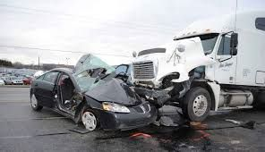
PROBLEMS
WE WILL SOLVE THE PROBLEMS
01
INCREASED NUMBER OF ACCIDENTS LEADING TO LOSS OF LIVES
Many transport companies struggle with managing the goods in transit as well as accidents that result to loses. Our solution involves creating a gadget that will monitor driver status and alart them when they loose concentration on roads making sure that they remain sober all the time.
02
LOSS OF PROPERTY AND BUSINESSES
03
UNLISENEDDRIVERS ON THE ROAD
transport sector is struggling to deal with unlisenced drivers. our solution will be monitoring drivers all the time to ensures that only licensed drivers handle cargo. in the event of new drivers along the way, there faces will be captured and sent to the control centre for detail match.
accidents lead to loss of lives , property and revenue, we are dedicated to ensuring that we mimimize causes of accidents as much as possible so as to mimimize loses.

Slide 5
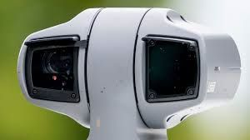


SOLUTIONS
01
ALLERTING DRIVER WHEN DIZZY
SOLUTIONS OF THE PROBLEMS
our solution will be able to allert drivers accross all our domain on their status and also allert the control room. this will help to advice the driver either to pack and relax or the change of driver.
02
CONFIRMING THE RIGHT DRIVER
through face image analysis the solution will be able to confirm the driver and match the details, this will avoid situations where drivers hand over responsibilities to their friends who are not qualified, inenvironments where there is no monitoring.
02
MAPPING CORRECT SPEED LIMITS
the solution will also reverage on the gps and speed technologies to ensure that speeds are updated in real time to the control centre, an allert will also be issued when speed limit is violated.
Thynk Unlimited

Slide 6
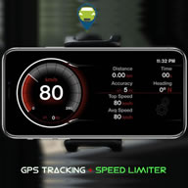
OUR PRODUCT
WHAT WE COULD DO
FACE RECOGNITION
INSTANT ALLARTS
SPEED AND LOCATION MAPPING
Our agency specializes in strategic brand development, ensuring that your brand not only resonates with your target audience but also stands out in a crowded market.
Our data-driven approach ensures that every campaign is backed by insights, maximizing ROI and driving tangible results.
Content is king, and our agency excels in producing creative, engaging, and impactful content that resonates with your audience.

Slide 7
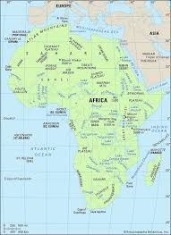
MARKET SIZE
Total Available Market (TAM)
our total market size is the whole of africa, we are targetting africa continent where the transport sector is majorly roads
OUR CLIENTS COME FROM TRANSPORT SECTOR
Serviceable Available Market (SAM)
our SAM is currently east africa, there are many businesses that involve movement of goods through road networks, with this we are able to angage transit companies who move goods from port of mombasa to upcountry or to other landlocked countries. we are also targeting public transport campanies.
Serviceable Obtainable Market (SOM)
our SOM is kenya market, we cant to engage public service vehicles especially those for long distances and also commercial vehicles, we will sensitize them on the benefits of our solution and how it will minimize the risk of loses in their business, we also plan to engage law makers at different stages and sell our product. if improved we can enter into aggrement with government to manufacture and sell the soluton to them
With a africa development goals, our market team have focused on bringing safety to african roads.

Slide 8
COMPETITORS
01
SPEED GOVERNORS
OUR COMPETITORS
this are mandated to install the speed limit devices to all public operated vehicles
02
CARGO TRACKING AND ALLARMS
they install tracking devices to vehicles to monitor their location and offer alarm responses in the event of emergency.
.
Thynk Unlimited

Slide 9
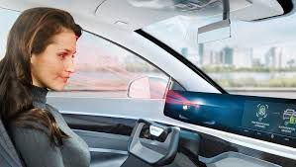
COMPETITIVE ADVANTAGE
01
DRIVER SAFETY
we are able to capture and display the details of driver in real time, it is easy to notice distress when there is danger.
02
ACCIDENT REDUCTION
able to monitor driver status and advice accordingly in the event of fartigue, this helps avoid near misses or accidents that can result fron fartigue
Thynk Unlimited

Slide 10

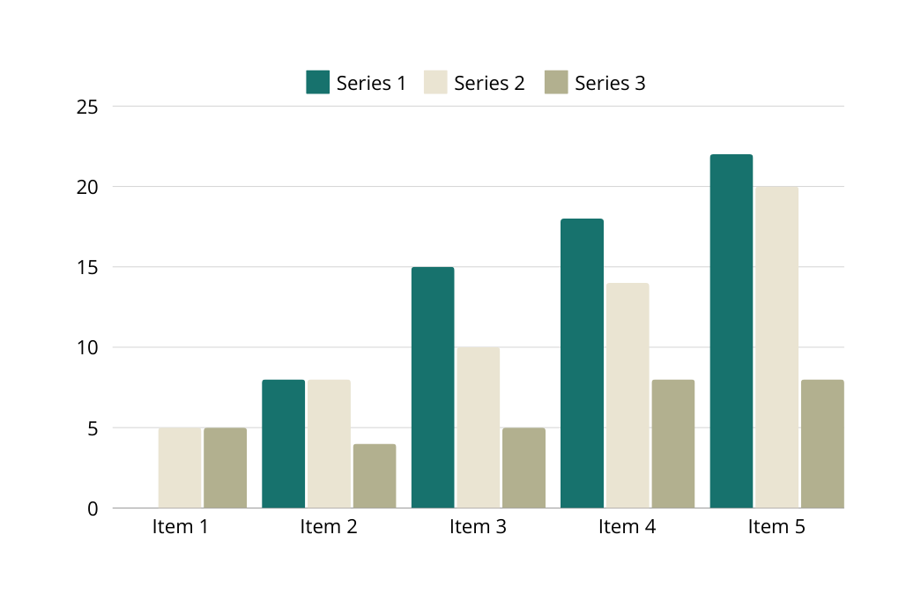
BUSINESS MODEL
OUR BUSINESS MODEL
Our business model thrives on creating an electronic device which we sell by doing a sell and free installation after which we charge annual renewal fee, we also charge repair and replacement fee.
We indent to angage policy makers to introduce product to be part of security transport requirements so that we when approved it an be included in public transport sector as requirement, with such we can engage in large scale manufacturing and integration into transport databases.

Slide 11
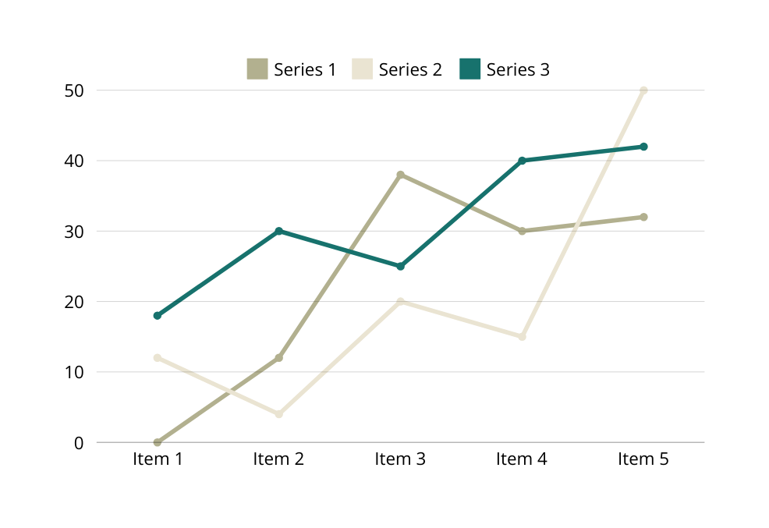

GO TO MARKET
CLIENT’S SATISFACTION
We are reaching the market through printing of bronchures and distributing them to large cargo handling companies and matatu transport saccos,
We also do advertisement on taxi related companies such as ubber who allows us to post our product on their social media platforms.
Freach out to cargo handling companies.
print bronchours and give them to drivers on the roads for overview.
angage law makers to publisize our products.

Slide 12
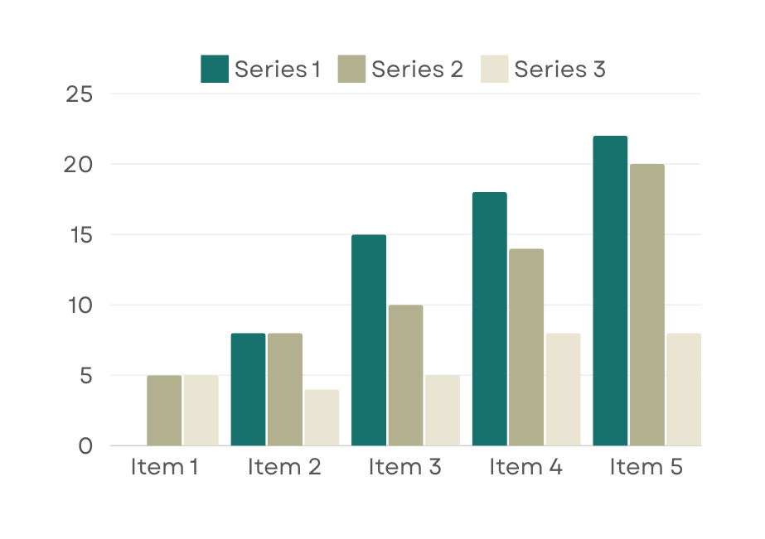
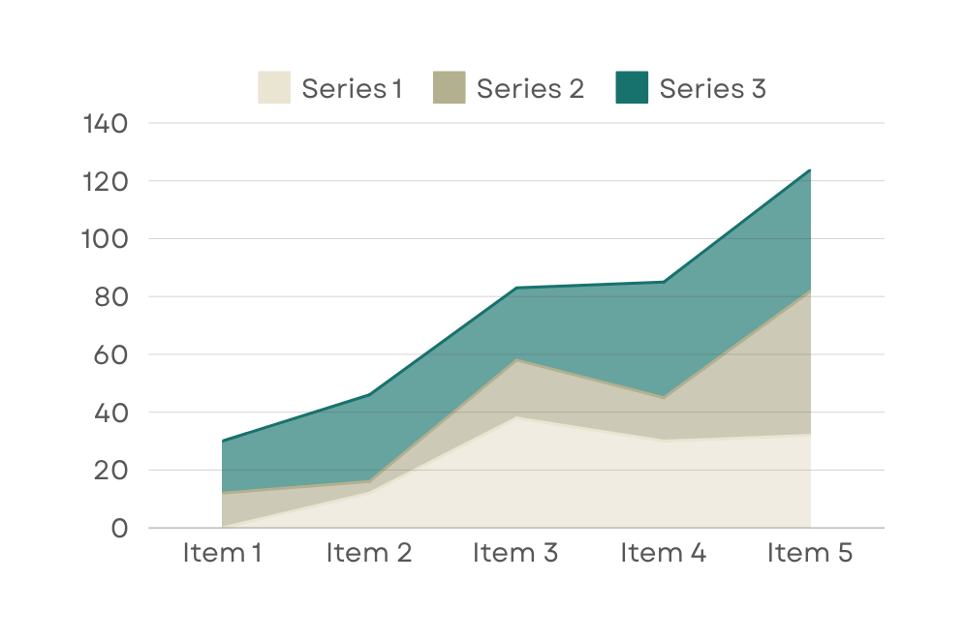
STATISTIC
Our Customer’s Satisfaction
Repeat Order Rate
The clients we have served have given as good feedback, companies that are handling long distance travels have reported improvement in terms of security of their products, and have reported reduced instances related to fartigue and sleep. Also this has ensured that only recognized drivers handle the cars that leading to competence and accountability.
This has let to positive recommendations and refferals leading to more sales and production of more units.

Slide 13

Our ask
$5 MILLION
We are asking for $5 million, to expand our market and production. We indent to use 15% of the money for advertisement, 50% to set up a small manufacturing and sales centre and and to bring on board more expertise and workfore.
$5 MILLION
90% | Our client loyalty speaks volumes as evidenced by a robust repeat order rate
99% | Our paramount focus on client satisfaction is the bedrock of our agency's success.
$5M

Slide 14
THE TEAM
LEAD ENGINEER IN CHARGE OF
PRODUCT TESTING AND DEPLOYMENT
GRAGUATE ELECTRICAL ENGINEER AND IT EXPERT
LEAD IT APPLICATION SUPPORT ENGINEER.
GRATUATE SOFTWARE ENGINEER
SALES AND CUSTOMER MANAGER
BACHELORS OF COMMERCE
WITH
CPA IV
K.NALIANYA
CLINTON MINYA
MILKA MWARIA

Slide 15
THANK YOU
FOR YOUR NICE ATTENTION
Telephone
Address
Website
December 2023
+123-456-7890
123 Anywhere St., Any City,
ST 12345
www.reallygreatsite.com

